Slide 1
Named entities as index fossils in the Medieval German translation of Marco Polo's travel account

Slide 2
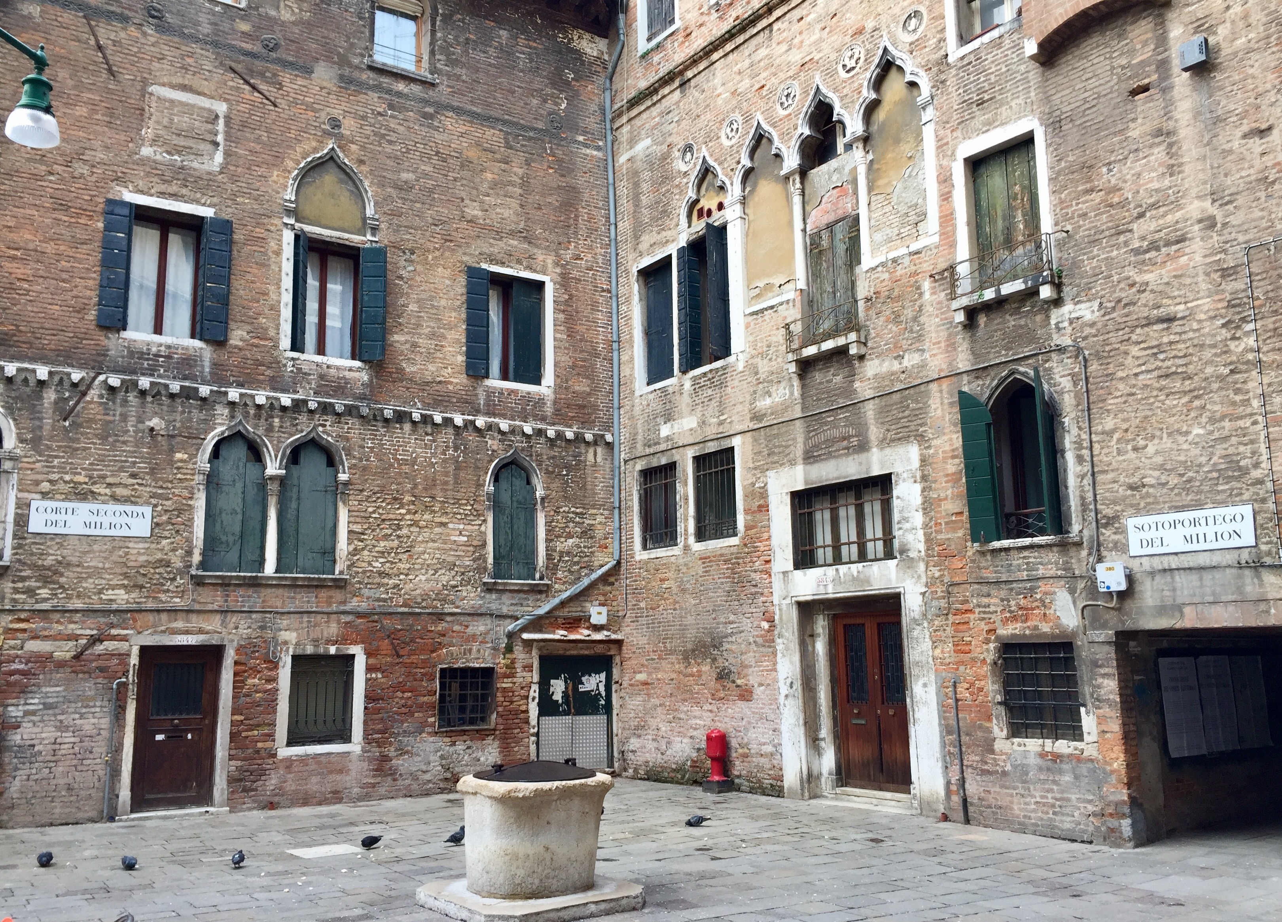
Marco Polo
Venetian traveller, 1254-1324
Family of merchants
1259-60: Niccolò and Maffeo Polo (Marco’s father and uncle) set off on their first journey from Constantinople
1269: back to Venice, Niccolò finds out he has a son
1271: back on the road, with a teenager Marco Polo
House of the Polos, sestiere of Cannaregio

Slide 3
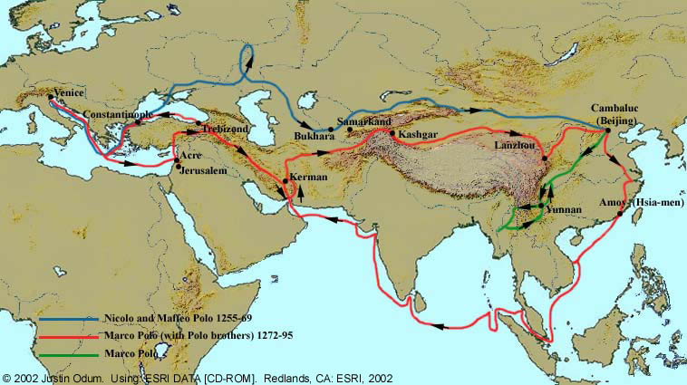
Travels

Slide 4
Captive writers
Marco Polo is back in 1295
Tensions between Venice and Genoa in the 1290s
He is put to prison in Genoa, where he meets Rustichello da Pisa
Together, they write the Devisement dou Monde
Original ms. is lost (of course!)

Slide 5
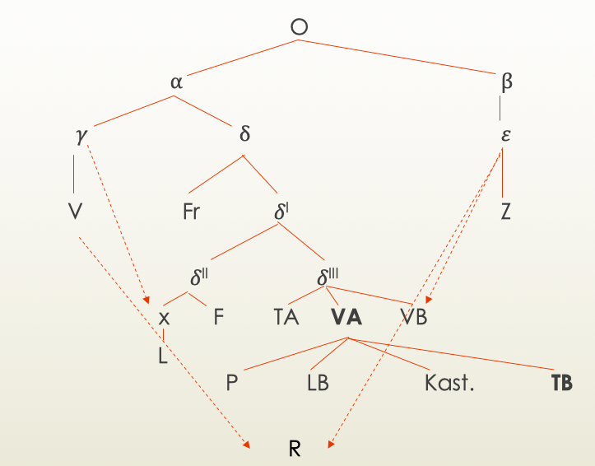

Textual tradition
13 languages;
25 versions;
141 witnesses

Slide 6
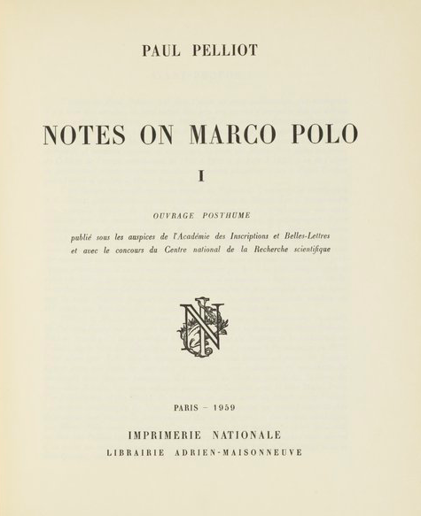
Trends in the literature: realia
Realia: Medieval Latin for “real things” → translation theory
Culturally connoted
Person names, place names and common names locally characterised (animals, plants, concepts...)
Historiographical sources

Slide 7
What makes these words special
All realia behave like proper names in translation and thus also in scribal practice (and language contact)
”Words from nowhere” (Cruse 2017)
”Tout peut être nom propre” (Molino 1982)
Semantics does not need to be interpretable for them to be functional (but they can have a describing function)
Resistant to translation and, similarly, to diachronical change (if not substituted) → “semantica evanescente” (Reginato 2016)

Slide 8
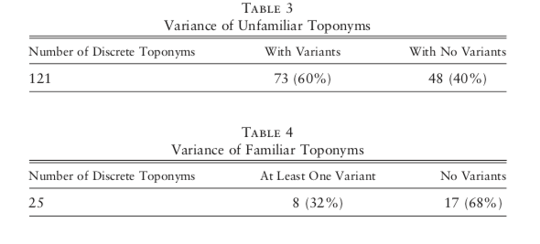
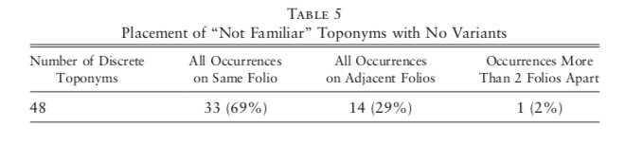
Uncertainty as an almost sure sign (Cruse 2017)
Traditional approach: localising place names on a map
But: misunderstandings! ≠ contemporary reception
Number of variants inversely proportional to the degree of knowledge of the scribe

Slide 9
Index fossils in language and philology (Borlandi 1962, Andreose 2015, Reginato 2016, etc.)
Realia often show clear traces of the languages they have gone through
Reginato (2016) proved that the archetype of version K was Catalan:
Proper names belonging to a specific language system: Jordi Kc, Kf, Ka vs. Georgie F
And that the source text of the Catalan translation was French:
Wrong segmentation: qui s‘apela Doumangui Kc, province de Doumanguy Kf, provincia de Daumangui Ka vs. provence do Mangi F

Slide 10

Marco Polo’s work in Germany
Two German translations of the Devisement dou Monde in the Middle Ages: VG₃, 1 witness; DI, 5 witnesses
DI has never been edited up to now, but…
3 witnesses actually relevant: a manuscript, a fragment and an incunabulum (the other 2 are codices descripti: ms. 28 and a later incunabulum)
Do they descend from one common antecedent? Was the incunabulum copied from the ms.? Or vice versa?

Slide 11
Realia come into play: going by elimination
Tuscan (TB) | Cgm 696 | Nürnberg 1477
Zetazi | Zeraſcz (165v) | Zerazi (13r)
Cretiman | Certeman (167r) Certiman (167v) | Crecinam (13v)
(lo) Veglio | Lovelgio (173r) Velgio (176r) Felgio (176r) | Veglio (16r)
Muleta | Muleta (173r) Mneta(173r) | Avletta (16r)
Temul | Temulo (214r) | Tenolo (32r)
Gauidi | Ghauidi (220v) | Ghamdi (34v)
Mangu Can | Manghachan (217v) | Manghathan (33r)
Guglielmo da Tripoli | Wilhalm von Tripoli (146r) | Quigliclino von Tripoli (5r)
Chingiutalas | Chiungiataſal (186r) Chiungataſal (187v) | Chinugiataſal (21r)
Natigai | Flatighay (191v) | Patighay (23r)

Slide 12
A riddle
In cgm 696 (and in cgm 252, but this is irrelevant for now) one finds the name Wilhalm von Tripoli. In the incunabulum the same person is called Quigliclino von Tripoli – Quigliclino being a non existing name. What was the reading in the antecedent?
G u gli e l m o
Q ui gli c l in o

Slide 13
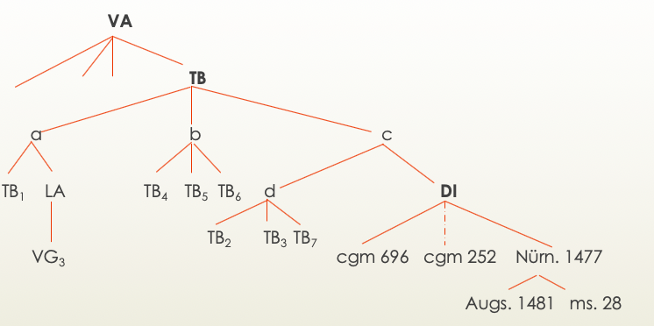
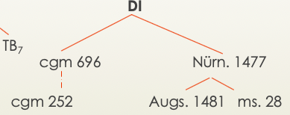
Zooming into the stemma

Slide 14
Named entities in the encoding
Encoding cgm 696:
<placeName ref="#gauidi" resp="#cgm696">Ghauidi</placeName>
Encoding the incunabulum:
<placeName ref="#gauidi" resp="#inc1477">Ghamdi</placeName>
Separate file:
<listPlace> <place id="gauidi"> <placeName>Gauidi</placeName> <note>Comment here</note> <location> <geo>Coordinates</geo> </location> </place> </listPlace>

Slide 15
Visualising variance With Marcel Schaeben (CCeH)
Localisation of the place names on different maps:
a modern map
Fra Mauro‘s Mappamundi (Venice, 1459)
Walsperger‘s map (Konstanz, 1448)

Slide 16
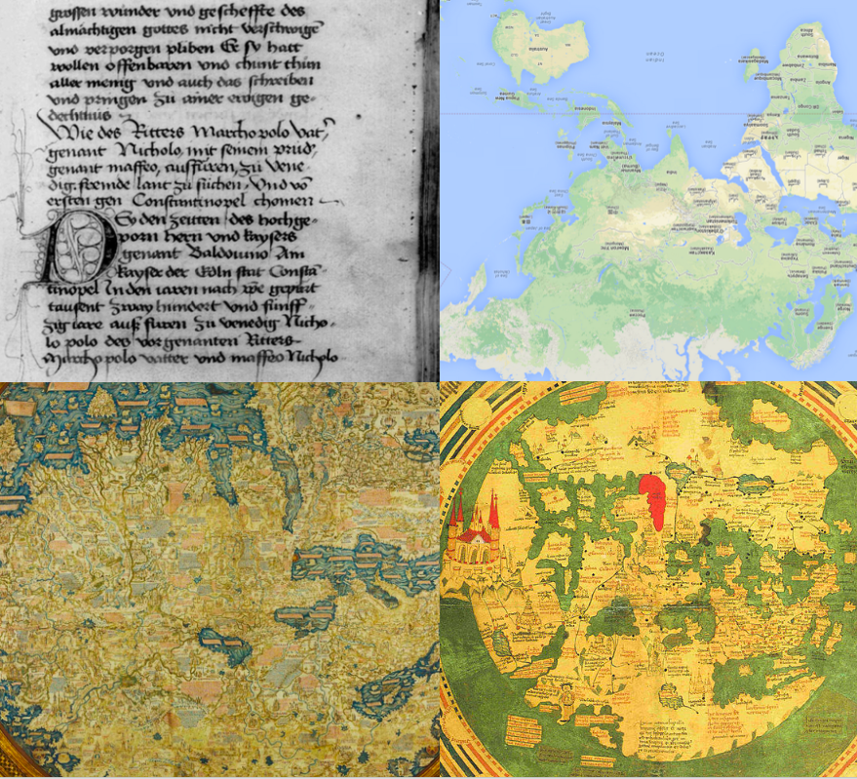
Visualising variance With Marcel Schaeben (CCeH)
Localisation of the place names on different maps:
a modern map
Fra Mauro‘s Mappamundi (Venice, 1459)
Walsperger‘s map (Konstanz, 1448)

Slide 17
Visualising variance With Marcel Schaeben (CCeH)
Localisation of the place names on different maps:
a modern map
Fra Mauro‘s Mappamundi (Venice, 1459)
Walsperger‘s map (Konstanz, 1448)
Mapping of the variance → to visualise knowledge and uncertainty
All the more interesting if (or rather when) the other redactions of the Devisement dou Monde are included…

Slide 18
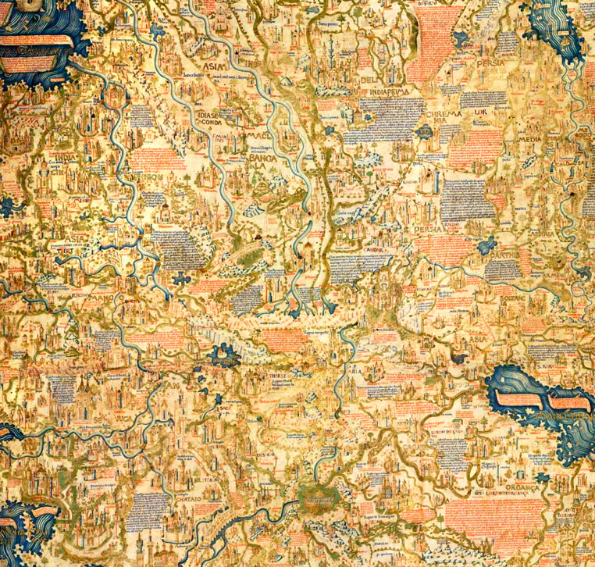


Visualising variance With Marcel Schaeben (CCeH)
India:
12 variants
(Pelliot 1959)
Localisation of the place names on different maps:
a modern map
Fra Mauro‘s Mappamundi (Venice, 1459)
Walsperger‘s map (Konstanz, 1448)
Mapping of the variance → to visualise knowledge and uncertainty
All the more interesting if the other redactions of the Devisement dou Monde are included…
Chataio: 40 variants (Pelliot 1959)

Slide 19
…meanwhile in Venice
Project for a new digital scholarly edition of Marco Polo’s work (E. Burgio, S. Simion, M. Buzzoni; R. Rosselli Del Turco, C. Martignano, E. Cugliana)
The edition will include 13 redactions of the Devisement dou Monde and a critical translation into English
Encoded in XML TEI and published in EVT (Edition Visualization Technology)
Geographical coordinates are already being included in the data → the material will then be ready for the maps

Slide 20
Bibliography
Amatucci, Eleonora. La redazione toscana B del Milione di Marco Polo: edizione critica [tesi di laurea]. Firenze: Universita degli Studi di Firenze, 1984
Andreose, Alvise. “La stesura del Devisement dou monde: interferenze dall’esame dei toponimi orientali”. Studi mediolatini e volgari, vol. 61 (2015): 5-23
Borlandi, Franco. “Alle origini del libro di Marco Polo” in Studi in onore di Amintore Fanfani, vol. 1, Milano: Giuffrè, 1962: 105-147
Burgio, Eugenio, Marina Buzzoni e Antonella Ghersetti (a cura di). Dei viaggi di messer Marco Polo / Giovanni Battista Ramusio; edizione critica digitale progettata e coordinata da Eugenio Burgio, Marina Buzzoni, Antonella Ghersetti; a cura di Samuela Simion e Eugenio Burgio, Venezia: Edizioni Ca’ Foscari-Digital Publishing, 2015 <http://edizionicafoscari.unive.it/it/edizioni/libri/978-88-6969-00-06/giovanni-battista- ramusio/> (ultimo accesso: 20/05/18)
Cruse, Mark. “A Quantitative Analysis of Toponyms in a Manuscript of Marco Polo’s Devisement du monde (London, British Library, MS Royal 19 D 1)”. Speculum 92, no. S1 (2017): S247–64. <https://doi.org/10.1086/694170> (ultimo accesso: 20/05/18)
Engels, Peter (a cura di). Wilhelm von Tripolis: Notitia de Machometo: De statu Sarracenorum. Würzburg: Echter, 1992
Gadrat-Ouerfelli, Christine. Lire Marco Polo au Moyen Age: traduction, diffusion et réception du Devisement du monde. Terrarum orbis 12. Turnhout: Brepols, 2015
Gardiner, Alan. The Theory of Proper Names: A Controversial Essay. 2nd ed. London: University Press, 1954.
Hoffmann, István. “The name as a historical source”. Conference paper, 6th Conference of Hungarian Onomastics. Balatonszárszó: 2007 <http://mnytud.arts.unideb.hu/onomural/kotetek/ou7/06hoffmann.pdf> (ultimo accesso: 20/05/18)
Molino, Jean. “Le nom propre dans la langue”. Langages 16, No. 66 (1982): 5-20
Pelliot, Paul. Notes on Marco Polo. 3 voll. Parigi: Imprimerie nationale, 1959-1973
Polo, Marco. Il Milione / Prima Edizione Integrale, a Cura Di Luigi Foscolo Benedetto, Sotto Il Patronato Della Citta Di Venezia. Firenze: L. S. Olschki, 1928
Reginato, Irene. “La variazione lessicale nel Milione: interferenza linguistica e costanti interpretative” (in corso di stampa)
Reginato, Irene. “I nomi propri come ‘fossili-guida’ nello studio filologico-linguistico di un testo. Il caso della Versione K del Devisement du Monde” in Nomina sunt…? L’onomastica tra ermeneutica, storia della lingua e comparatistica, a cura di Maria Pia Arpioni, Arianna Ceschin e Gaia Tomazzoli. Venezia: Edizioni Ca’ Foscari, 2016: 65-76
Steidl, Nicole. Marco Polos “Heydnische Chronik”. Die mitteldeutsche Bearbeitung des “Divisament dou monde” nach der Admonter Handschrift Cod. 504. Aachen: Shaker Verlag, 2010
TEI Consortium, eds. Guidelines for Electronic Text Encoding and Interchange. [ultima modofica: 31.01.2018] <http://www.tei-c.org/release/doc/tei-p5-doc/en/html/> (ultimo accesso: 20/05/18)
Wagner, Kurt. Echte und unechte Ortsnamen. AbhandI. Akad. Wiss. u. Lit. Mainz, Geistes- u. Sozialwiss. KI. 1967, No. 3. Mainz/Wiesbaden: 1967

Slide 21
In lieu of a conclusion…
«Nunc scripsi totum pro Christo da mihi potum»
(Scribal complaint from: Library of the University of Cambridge, Kk II 19, f. 101: “Now I have written everything, for God‘s sake give me a drink”)
Thank you!
P.S. What other ways of using realia do you know
or can you think of?

